Slide 1

DOM Manipulation & Animation

Slide 2
DOM
DOM (Document Object Model) is a platform & language neutral interface that will allow programs & scripts to dynamically access & update the content, structure & style of documents.
It means DOM is an API to work with HTML-like document. Manipulating DOM means using this API to change the document: adding, removing or moving elements.

Slide 3
<head>
<script src="js/jquery-3.3.1.min.js"></script>
<style>
.myClass {
color:yellow;
background:blue;
}
</style>
</head>
<body>
<div id="container">
<button id="btn1">Tombol</button>
<p class="para1">Ini paragraf 1</p>
<p class="para2">Ini paragraf 2</p>
</div>
<script>
$(document).ready(function(){
// $('p.para1').css({color:'red', background:'yellow'});
// $('p.para2').addClass('myClass');
// $('p.para2').removeClass('myClass');
});
</script>
</body>
DOM Manipulation Add/Remove Class

Slide 4
<head>
<script src="js/jquery-3.3.1.min.js"></script>
<style>
.myClass {
color:yellow;
background:blue;
}
</style>
</head>
<body>
<div id="container">
<button id="btn1">Tombol</button>
<p class="para1">Ini paragraf 1</p>
<p class="para2">Ini paragraf 2</p>
</div>
<script>
$(document).ready(function(){
$('#btn1').click(function(){
$('p.para1').toggleClass('myClass');
$('p.para2').toggleClass('myClass');
});
});
</script>
</body>
DOM Manipulation Toggle Class

Slide 5
<body>
<div id="myDiv"></div>
<script>
$(document).ready(function(){
// $('#myDiv').text('Halo semuanya!');
// $('#myDiv').html('<h1>Halo!</h1>');
// alert($('#myDiv').text());
});
</script>
</body>
DOM Manipulation
Set Content Value

Slide 6
<body>
<p class="para1">Ini paragraf 1</p>
<p class="para2">Ini paragraf 2</p>
<ul>
<li>Ini list 1</li>
<li>Ini list 2</li>
<li>Ini list 3</li>
</ul>
<script>
$(document).ready(function(){
// $('.para1').appendTo('.para2');
// $('.para1').prependTo('.para2');
// $('ul').append('<li>Ini append list</li>');
// $('ul').prepend('<li>Ini prepend list</li>');
// $('ul').before('<h4>Berikut adalah list:</h4>');
// $('ul').after('<h4>Demikianlah list.</h4>');
// $('ul').empty();
// $('ul').detach();
});
</script>
</body>
DOM Manipulation
Append & Prepend

Slide 7
<body>
<p class="para1">Ini paragraf 1</p>
<p class="para2">Ini paragraf 2</p>
<ul>
<li>Ini list 1</li>
<li>Ini list 2</li>
<li>Ini list 3</li>
</ul>
<script>
$(document).ready(function(){
var x = $('.para1').text();
$('ul').append('<li>' + x + '</li>');
});
</script>
</body>
DOM Manipulation
Append & Prepend

Slide 8
DOM Manipulation
Add Attribute
<body>
<a href="http://google.com">Klik!</a>
<script>
$(document).ready(function(){
// $('a').attr('target','_blank');
// alert($('a').attr('href'));
// $('a').removeAttr('target');
});
</script>
</body>

Slide 9
DOM Manipulation
Wrap Elements
<body>
<p class="para1">Ini paragraf 1</p>
<p class="para2">Ini paragraf 2</p>
<script>
$(document).ready(function(){
// $('p').wrap('<h1>');
// $('p').wrapAll('<h1>');
});
</script>
</body>

Slide 10
DOM Manipulation
Print Array On Console
<body>
<script>
$(document).ready(function(){
var myArr = ['Andi','Budi','Caca'];
$.each(myArr, function(i,val){
console.log(val);
});
});
</script>
</body>

Slide 11
DOM Manipulation
Print Array On Web Page
<body>
<ul id="users"></ul>
<script>
$(document).ready(function(){
var myArr = ['Andi','Budi','Caca'];
$.each(myArr, function(i,x){
$('#users').append('<li>'+x+'</li>');
});
});
</script>
</body>

Slide 12
DOM Manipulation
Convert Lists to Array
<body>
<ul id="list">
<li>Andi</li>
<li>Budi</li>
<li>Caca</li>
</ul>
<script>
$(document).ready(function(){
var newArr = $('ul#list li').toArray();
$.each(newArr, function(i,val){
console.log(val.innerHTML);
});
});
</script>
</body>

Slide 13
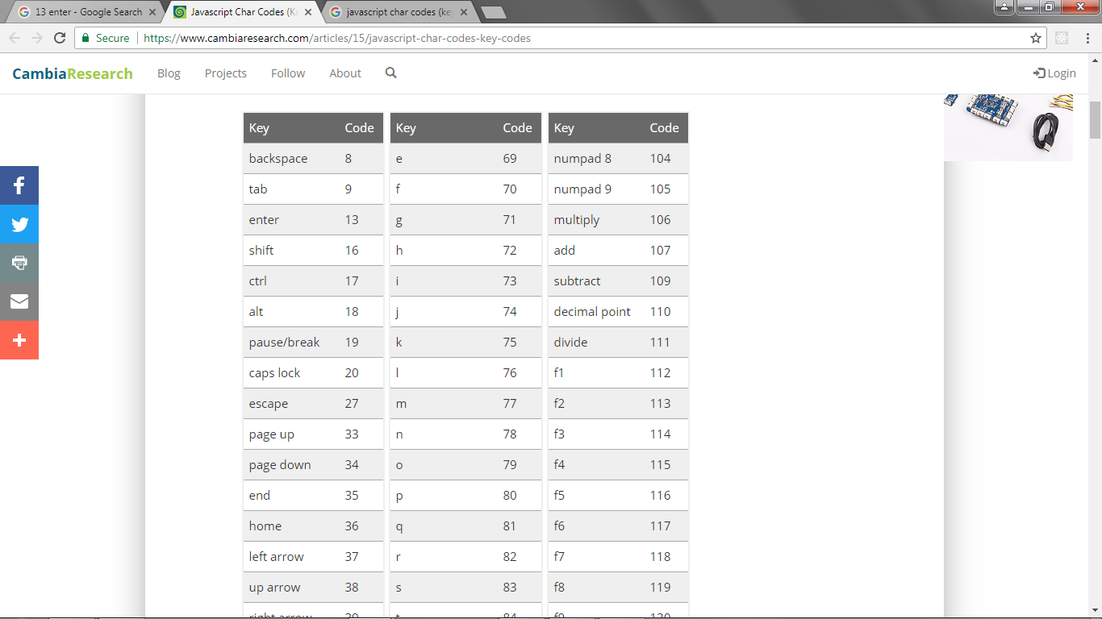
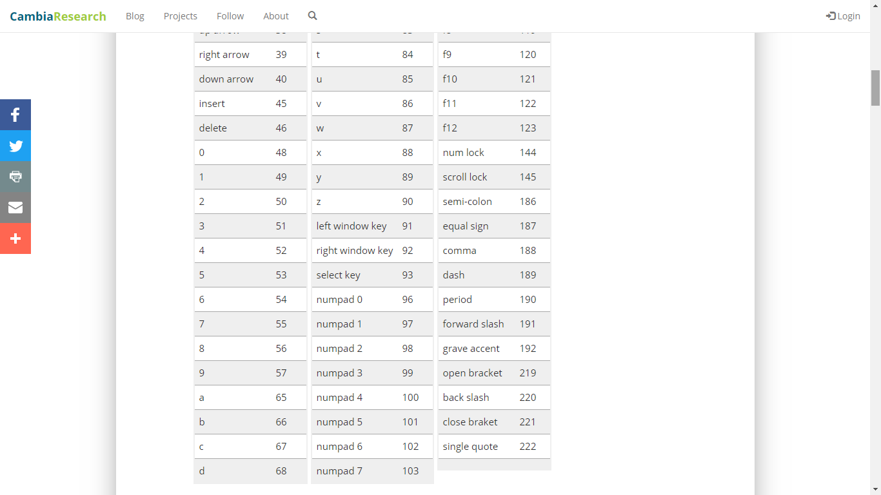
JavaScript Key Codes

Slide 14
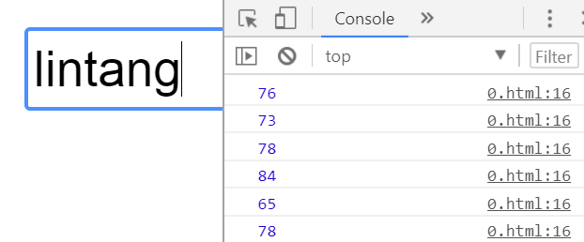
DOM Manipulation
JavaScript Key Codes
<body>
<input type="text">
<script>
$(document).ready(function(){
$('input').keyup(function(x){
var code = x.which;
console.log(code);
});
});
</script>
</body>

Slide 15
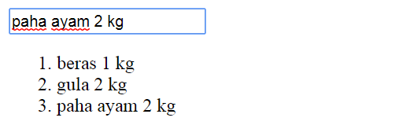
DOM Manipulation
Input & Add List
<body>
<input type="text" id="newItem">
<ol></ol>
<script>
$(document).ready(function(){
$('#newItem').keyup(function(x){
var code = x.which;
if(code==13){
x.preventDefault();
$('ol').append('<li>'+x.target.value+'</li>');
};
});
});
</script>
</body>

Slide 16
DOM Manipulation
Input, Add List & Refresh
<body>
<input type="text" id="newItem">
<ol></ol>
<script>
$(document).ready(function(){
$('#newItem').keyup(function(x){
var code = x.which;
if(code==13){
x.preventDefault();
$('ol').append('<li>'+x.target.value+'</li>');
$(':text').val('');
// x.target.value = '';
};});});
</script>
</body>

Slide 17
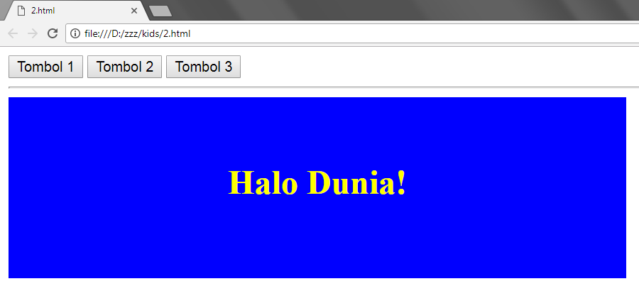
Animation

Slide 18
Template
#part 1
<head>
<script src="js/jquery-3.3.1.min.js">
</script>
<style>
#box{
background:blue;
color:yellow;
width:500px;
height:90px;
padding:40px;
text-align:center;
}
</style>
</head>

Slide 19
Template
#part 2
<body>
<div id="container">
<button id="tombol1">Tombol 1</button>
<button id="tombol2">Tombol 2</button>
<button id="tombol3">Tombol 3</button>
<hr>
<div id="box"><h1>Halo Dunia!</h1></div>
</div>
<script>
$(document).ready(function(){
});
</script>
</body>

Slide 20
Animation

Slide 21
Animation
Fade Effects
<script>
$(document).ready(function(){
$('#tombol1').click(function(){
$('#box').fadeOut();
});
$('#tombol2').click(function(){
$('#box').fadeIn();
});
$('#tombol3').click(function(){
$('#box').fadeToggle();
});
});
</script>

Slide 22
Animation
Fade Effects Param
<script>
$(document).ready(function(){
$('#tombol1').click(function(){
$('#box').fadeOut('slow');
});
$('#tombol2').click(function(){
$('#box').fadeIn('fast');
});
$('#tombol3').click(function(){
$('#box').fadeToggle(2000);
});
});
</script>

Slide 23
Animation
Fade Effects Func
<script>
$(document).ready(function(){
$('#tombol1').click(function(){
$('#box').fadeOut(2000, function(){
$('#tombol1').text('Box Hilang!');
});
});
});
</script>

Slide 24
Animation
FadeTo Effects
<script>
$(document).ready(function(){
$('#tombol2').click(function(){
$('#box').fadeTo(1000, 0.4);
});
$('#tombol3').click(function(){
$('#box').fadeTo(1000, 0.8, function(){
alert('Halo semuanya!');
});
});
});
</script>

Slide 25
Animation
Slide Effects
<script>
$(document).ready(function(){
$('#tombol1').click(function(){
$('#box').slideUp(1000);
});
$('#tombol2').click(function(){
$('#box').slideDown(1000);
});
$('#tombol3').click(function(){
$('#box').slideToggle(1000);
});
});
</script>

Slide 26
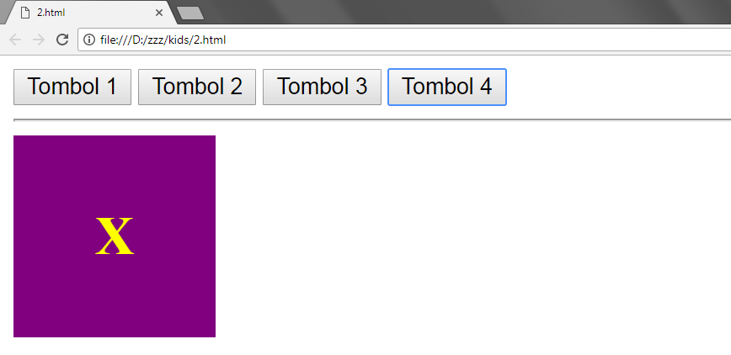
Animation

Slide 27
Template
#part 1
<head>
<script src="js/jquery-3.2.1.min.js">
</script>
<style>
#box{
background:purple;
color:yellow;
width:80px;
height:80px;
position:relative;
text-align:center;
padding: 20px
}
</style>
</head>

Slide 28
Template
#part 2
<body>
<div id="container">
<button id="tombol1">Tombol 1</button>
<button id="tombol2">Tombol 2</button>
<button id="tombol3">Tombol 3</button>
<button id="tombol4">Tombol 4</button>
<hr>
<div id="box"><h1>X</h1></div>
</div>
<script>
$(document).ready(function(){
});
</script>
</body>

Slide 29
Animation

Slide 30
Animation
Animate Effects
<script>
$(document).ready(function(){
$('#tombol1').click(function(){
$('#box').animate({
left: 300
});
});
$('#tombol2').click(function(){
$('#box').animate({
left: 0
});
});
});
</script>

Slide 31
Animation
Animate Effects
<script>
$(document).ready(function(){
$('#tombol3').click(function(){
$('#box').animate({
top: 200
});
});
$('#tombol4').click(function(){
$('#box').animate({
top: 0
});
});
});
</script>

Slide 32
Animation
Animate Effects
<script>
$(document).ready(function(){
$('#tombol1').click(function(){
$('#box').animate({
left: 0,
height: '400px',
width: '400px',
opacity: '0.5'
}, 2000);
});
});
</script>

Slide 33
DOM Manipulation & Animation

